Slide 1
AngularJS
What angular is?
What is SPA (Single page application)?
Angular Version History
Project Setup and First App.
Basic setup using Bootstrap for styling.
Project Structure and app component
Angular application flow
Angular application flow diagram
What is appmodule and appcoment.
How to create component?
Nested component

Slide 2
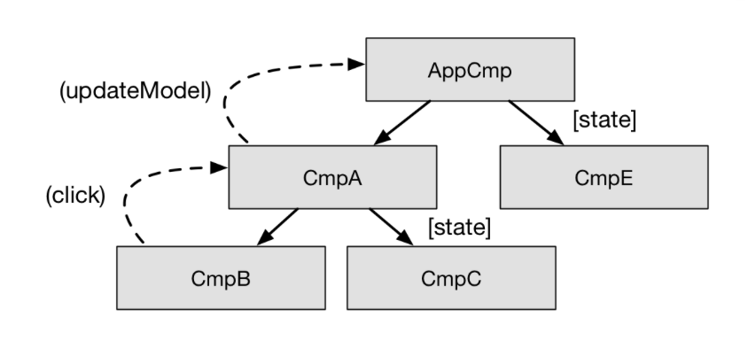
What Angular JS is?
Angular is JS framework which allows you to create reactive single page web application.
An Angular application is a reactive system. The user clicks on a button, the application reacts to this event and updates the model. The model gets updated, the application propagates the changes through the component tree
Single page application is where user can navigate different pages but at the end the remain within the same page.
SPA render everything with same page which give very reactive experience to user.
Example : https://angular.io/guide/security
Multipage app : https://www.amazon.in

Slide 3
What SPA is?
Why Single page application
SPA application is simple to deploy if compared to more traditional server side rendered applications.
If app will need to make calls to backend to get data but that is a separate server that can be build if needed with completely different technology like Node, Java or PHP.
It does not load content every time from server like multipage app which is poor user experience. The constant full page reload while in SPA after initial HTML page load no more HTML gets sent over the network only data gets requested from server or sent to the server.
So how does single page application works.
Tradition application which vast majority of todays public Internet the data to HTML transformation or rendering is being done on the server side.
In a SPA after application startup, the data to HTML transformation process has been moved from the server to the client – SPAs have the equivalent of a template engine running in your browser!
So the application will feel faster because less bandwidth is being used and no full page refreshers reoccurring as user navigates through the application.

Slide 4
Angular Version history
Angular 1
Angular 2
( rewritten basically big transformation happen and released 2016 and lots of concept added .
No need to learn Angular 1/Angular js to learn angular 2
Angular 4
Angular version 3 was skipped due to some internal version and instead they released Angular 4.
Angular 5 to 7.
Angular 8
So the latest one is angular 8 and reason behind to see so many version is angular team release major update on every six month.
There have been not many changes between 2 and 8 i.e no drastic change

Slide 5
Project Setup and First App
Install Dependencies
Node.js
Server-side language.
What we do with Node.js
We don’t write any code in Node but Node being used by the CLI to optimize and bundle our code.
What is NPM?
Node package manager to manage package dependency In angular project or some other library that framework uses.
To install Node.js and NPM
brew install node.
To update : brew upgrade node
To check the version node –v, npm -v
NPM will get install when you install node.js
Install Angular
sudo npm install –g @angular/cli@latest
ng new my-app
Say no to routing question and press enter again to go with Default “CSS” styling sheet.
cd my-app
Ng serve : To local server

Slide 6
Basic Setup using Bootstrap for Styling.
npm install - -save bootstrap@3
This will install locally in project
Now see package will be visible under
Node_modules
Bootstrap
Go to “appname”/ angular .json file, this file is to configure different dependencies of project
Go to “styles” : array since bootstrap will be used for styling html elements.
Configure/Add bootstrap
“node_module/bootstrap/dist/css/bootstrap.min.css”
or you can also
“node_module/bootstrap/dist/css/bootstrap.css”
Bootstrap.min.css has been minified. This means all the whitespace and other extra characters have been removed. This is commonly done for use in production, to reduce the size of the file. When developing, it is usually helpful to use the unminified version, since, as you said, it is readable.
Rerun ng serve to load new configuration

Slide 7
Project Structure and app component
How does browser or server knows that should render app.component.html file?
But app.component.html not serve by server
-> Index.htmt is the one file serve by the server
What is Index.html
If you remember angular is about to develop single page application and index.html is that single page.
Index.html is normal html file which having head section with title
But if you see of the index.html is interesting as we see it is having <app-root> tag which not an html tag.
<app-root> is component that is created by our app which is created through cli during project creation
All the files under app folder are related to that single app-root component only
There 5 diff files under app component folder and this app folder called app component.
app.component.css
app.component.html
App.component.ts
app.component.spec.ts
app.module.ts

Slide 8
Project Structure and app component
If you go in app.component.ts then there is selector holds value ‘app-root’ which clearly same is the one <app-root> tag one which same is in index.html
So basically app-root is the component file called app.component.html (template) what it will do is it will take full app.component.html template and embed inside in index.html file.
Lets cleanup app.component.html file and put some <h3> tag with title and rerun app see that same result appears in browser.
Question is How angular triggers or run over body of app.component.html file in index.html?
If you go in page open page source, will able to see that couple of scripts imports in index.html which injected by CLI automatically. So we just see app-root component in index.html file but we don’t see any script or app.component.html file code in index.html
But whenever “ng server” run it will create javascript bundles and add right imports in index.html file. This little convience functionality for us.
If you see index.html script imports it also contains our own app component script import.
So these script imports are present to be executed.

Slide 9
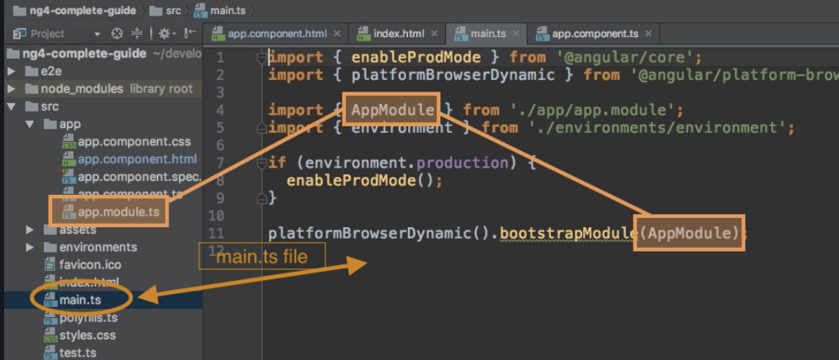
Angular application flow
Main.ts file
Has code which to be executed first and that is why it is called main.
There are 3 things in main.ts
Some import statements.
Condition to check whether it is production mode or not.
This the most important line 'platformBrowserDynamic().bootstrapModule(AppModule)’to understand.
Basically it bootstraps/starts angular application by passing app.module.ts

Slide 10
Angular application flow
App.module.ts
If you looked at this file it has some import statement and @NgModule,declarations, imports, providers and bootstrap array.
The most important line is bootstrap array which basically list all the components should be known to angular at point of time it analyse the our Index.html file.
So here the circle closes because here we refence our app components. So the angular app flow is something like this.
Angular means our main.ts file get started.
Main.ts bootstrap/start our application and pass app.modul.ts/app module as an argument
App.module.ts we bootstrap app components where it tell angular that it should know these components (bootstrap array of component) when it try to start itself.
Angular analyse these components and read the setup we pass in appcomponent.ts(whatever compoenents passed in app.module.ts bootstrap array) and figure out selector property of app component.
Then angular able to handle app-root component in index.html file figure that appcomponet has selector called ‘app-root’ app-root has attached some html code(.html file/template) which will be imports to index.html.

Slide 11
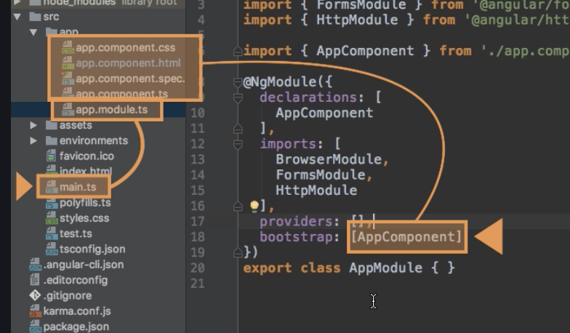
Angular application flow diagram

Slide 12
AppModule and Appcomponents
Components
Angular use components to build web pages
AppModule
Angular use appmodule to basically to bundle different pieces for example components, in to packages
There are 4 section in appmodule.
Declaration :
Here we declare any component which going to to be used in our app. So angular gets to know that these are the components to use. We register new component in declaration array while we also need to tell where to find this component with path so type scripts get to know where to find these component while bundling app.
Imports :
Where we can import some module since we can divide our application in multi module to outsource some task or work other module. Here we also import some of angular module as angular is also divided in different modules for different functionality.
BootStrap :
As I explained, it tells angular that it should know these components (bootstrap array of component) when it try to start itself.
Provides : will explain in detail in future sessions.

Slide 13
AppCompoent files
***.component.css file
Here you can have your css code
***.componenet.html
Is html template
.component.spec.ts
Is file to write unit test cases
Component.ts file
is type script class file
TypeScript is a primary language for Angular application development. It is a superset of JavaScript with design-time support for type safety and tooling.

Slide 14
How to create component
There is two way to create components.
Use CLI command ng g c `componentname` or user ng generate component `componentname`
G → Generate
C→ Component
Manually create component.
Create component.ts file
Create component.html file
Create component.css file
Create component.spec.ts if need to write unit test cases.
Register component in app.module.ts file

Slide 15
Nested/Multi component
Angular app can also have nested component.
Means component embed to inside another component
Steps to create nested component
Create component
Register component in app.module.ts file.
Add app component selector tag to parent component .html file
Now when embed parent component in app component html it also adds child component.

Slide 16
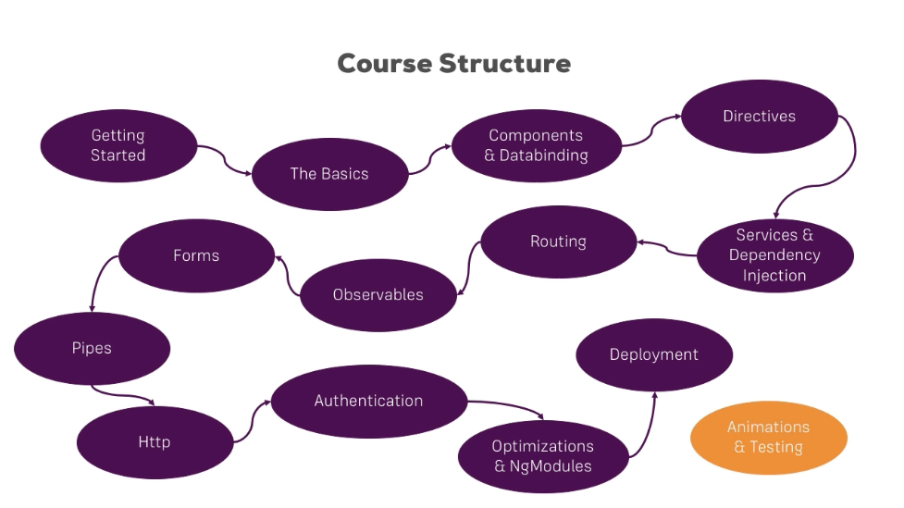
Angular Course Roadmap/Structure

